Slide 1



Magnetic Anomalies in the south polar region of the moon
Isabella Bryant
Dr. Lon hood, University of Arizona
Acknowledgement: Supported by the NASA Lunar Data Analysis Program

Slide 2
The goal
We know that there are magnetic anomalies present on the Moon’s surface that are caused by magnetization in its upper crust.
Our goal is to create a map of these anomalies in the South polar region of the Moon to be able to see their location and magnitude.

Slide 3


WHY IS IT Important to Study the south polar region of the moon?
NASA plans to send the next man and first woman to the Moon in 2024.
This mission, called Artemis, aims to lay the groundwork for putting humans on Mars
The astronauts will be landing in the south polar region, which is an ideal location because of the presence of water ice in permanently shadowed craters, almost continuous sunlight, and almost continuous communication with the Earth.

Slide 4
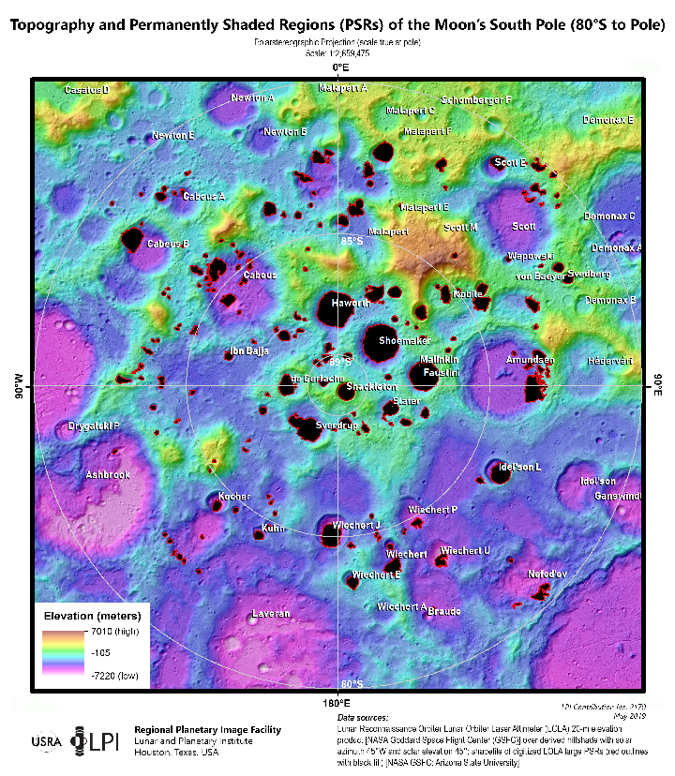
Water ice on the south pole
Topography and permanently Shaded Regions of the Moon’s South Pole
There is water ice present in the south polar region, likely placed there by comets
The ice is preserved due to permanently shaded areas in craters and possibly by the magnetic anomalies present in the area.
The magnetic anomalies are strong enough to deflect the solar wind ion bombardment, which can sputter away water ice. This is because the solar wind hits the south pole at a low angle, and therefore is weaker.
Stopar J. and Meyer H. (2019) Topography and Permanently Shaded Regions (PSRs) of the Moon’s South Pole (80°S to Pole), Lunar and Planetary Institute Regional Planetary Image Facility, LPI Contribution 2170,

Slide 5
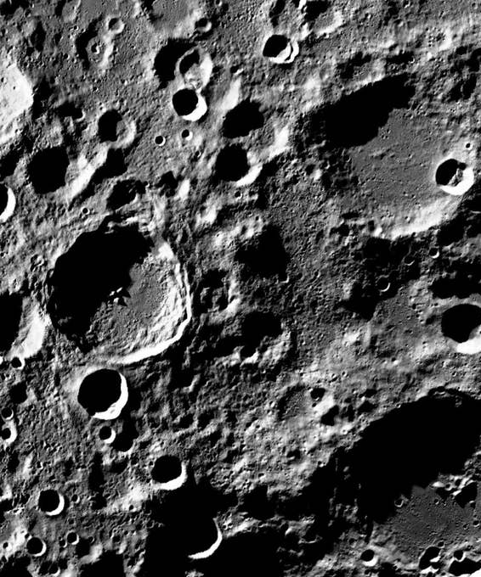
Origin of anomalies
We know that the Moon has suffered impacts from extraterrestrial objects from the existence of craters on its surface.
It is likely that at some point in its history, an iron-rich asteroid collided with the surface of the Moon, and the ejecta of this collision provided the iron which causes these anomalies.

Slide 6
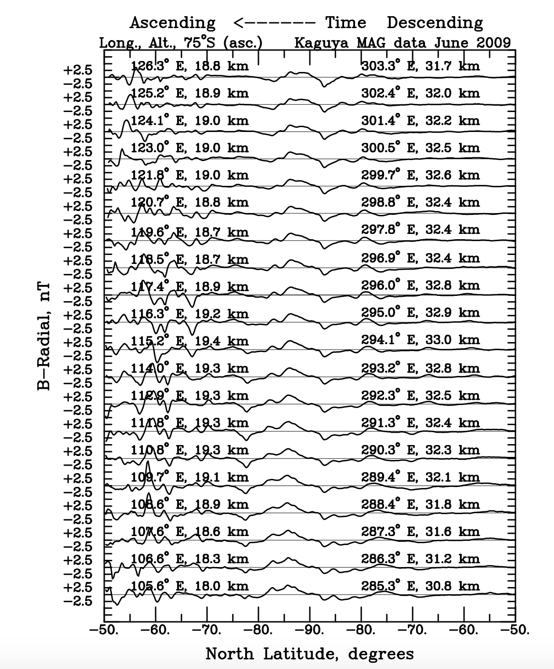
Mapping method
Took data from Kaguya/SELENE orbiter in 2009, plotted it, and chose the data with the least solar wind interference.
Modeled this data at a constant 30 km altitude with a simulated mesh of dipoles 15 km beneath the Moon’s surface using an equivalent source dipole technique.
Mapped this data in a stereographic projection with a 1 nT contour interval.

Slide 7
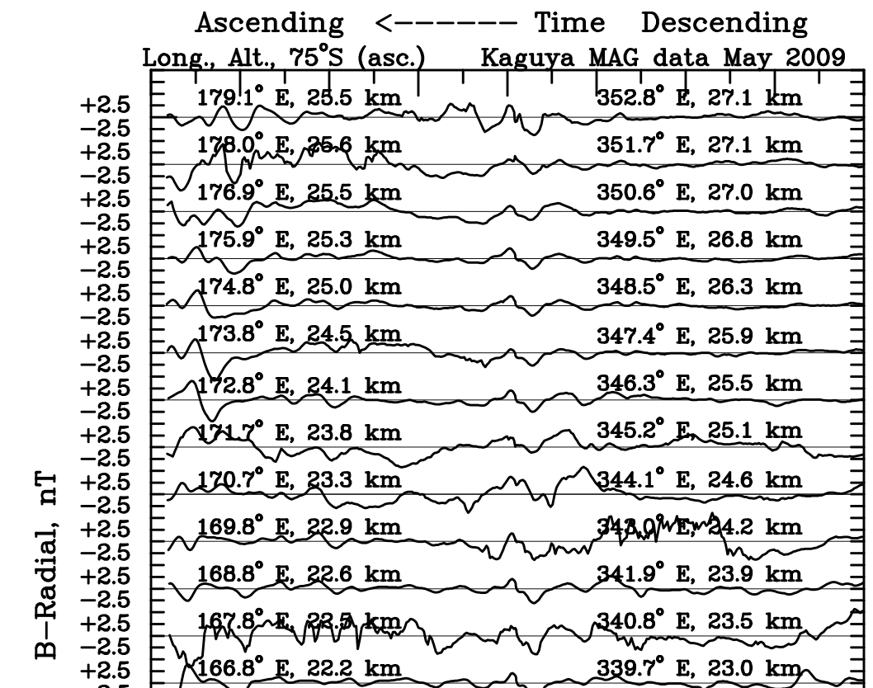
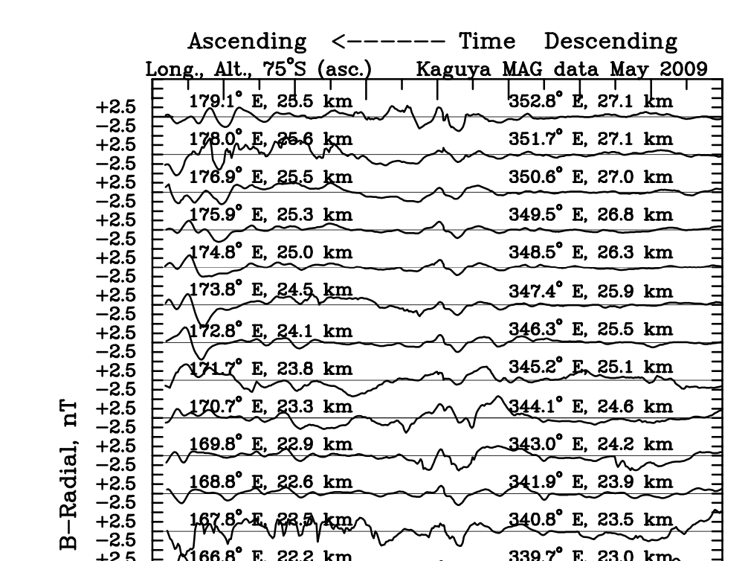
Data refinement

Slide 8
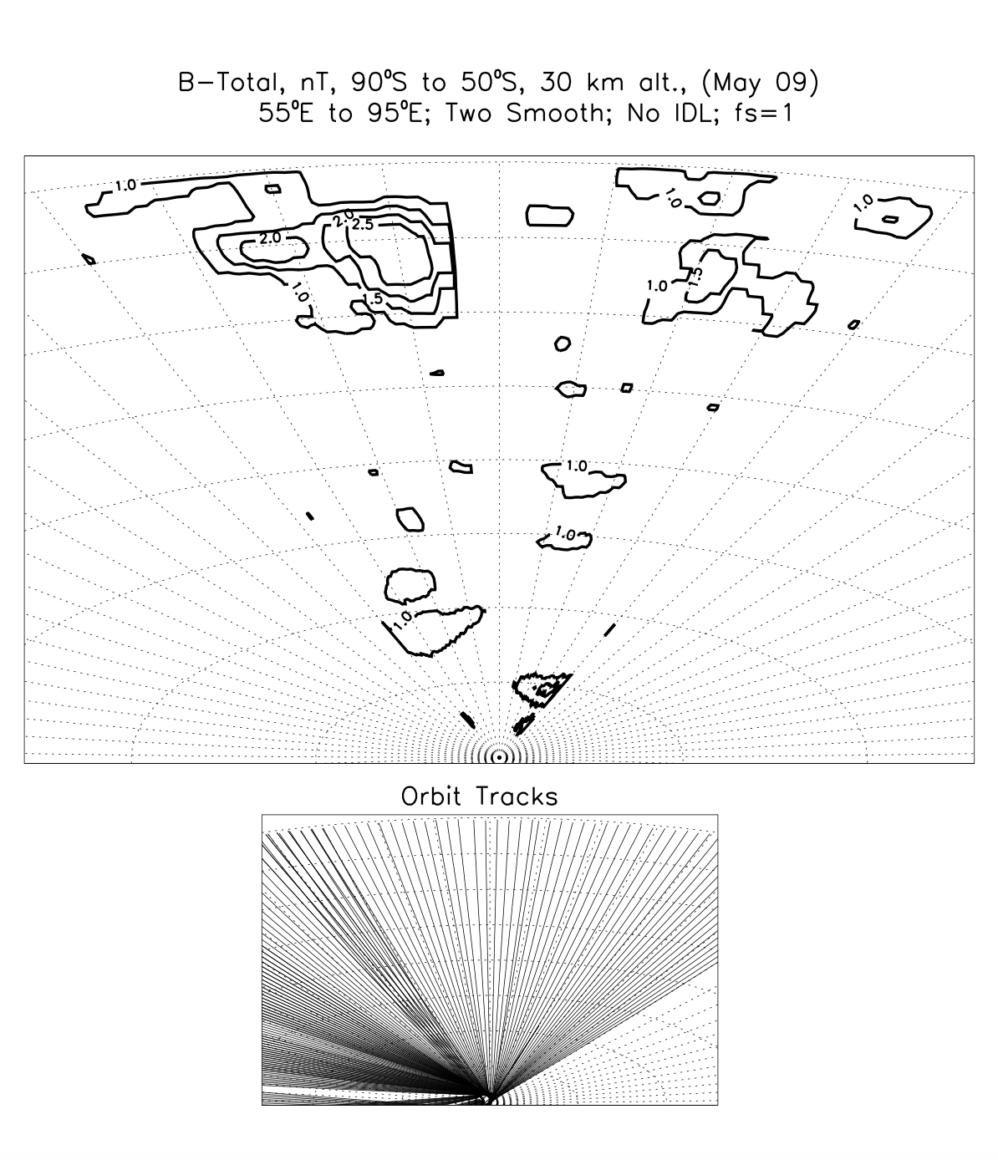
Error checking
We made the maps in 40 degree longitude increments. For example, this map is 55ºE to 95ºE.
Each map was checked with its corresponding SELENE data to make sure all anomalies were accurate and that none were missed.
Then, the 40 degree maps were joined together into the larger maps of the whole South pole.

Slide 9

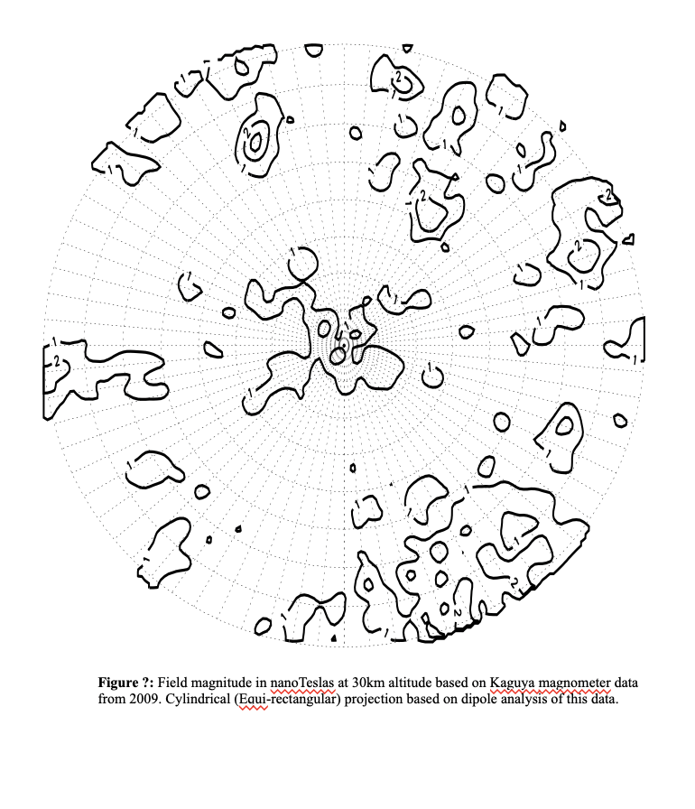
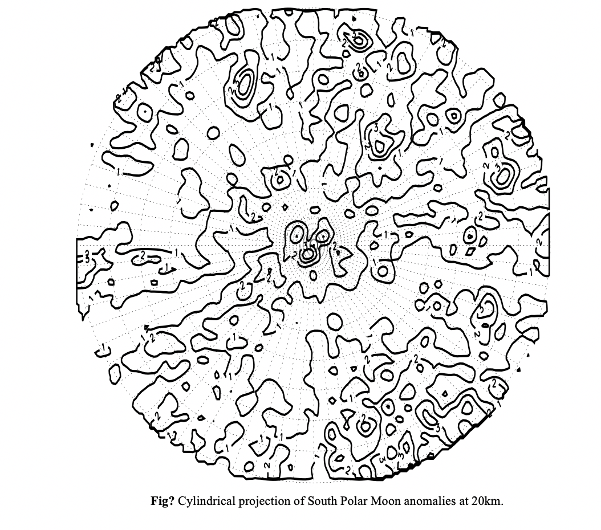
Notes:
We can see more details on the map when mapping at lower altitudes. We can see that the anomalies are clustered near the pole on both maps.

Slide 10
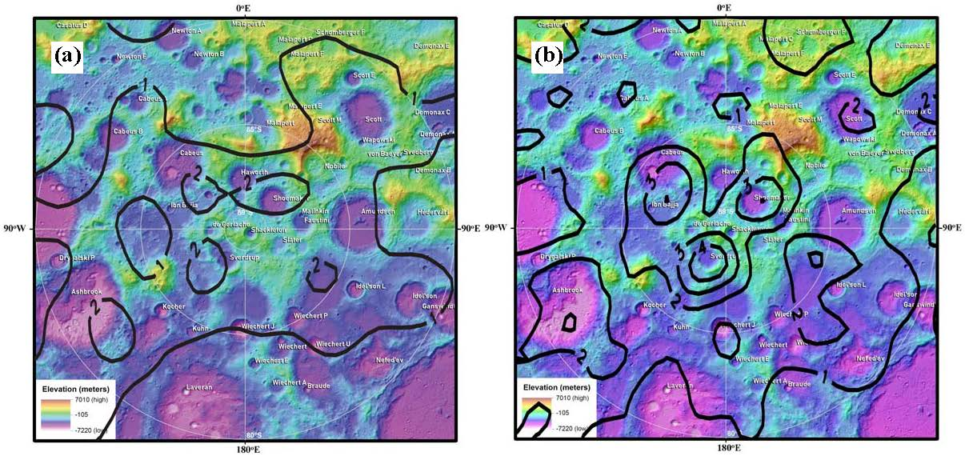
Lunar magnetic anomalies mapped at 30 km, produced by Tsunakawa (left) and 20 km, produced by Dr. Lon Hood and Isabella Bryant (right)

Slide 11
Summary and conclusions
There are crustal magnetic anomalies present near the surface of the south polar region of the Moon.
When modeled at a 30-kilometer altitude, the amplitude of these anomalies lies between approximately 1-3 nT.
These magnetic anomalies could help shelter the water ice present in the south pole from the solar wind.

Slide 12


Acknowledgements
Dr. Lon Hood for guiding me in this research
Michelle Coe and the Arizona Space Grant Consortium for giving me this opportunity
NASA Lunar Data Analysis program for funding
Dr. Lon Hood
Michelle Coe

Slide 13
Thank you!

